Slide 1
Holistic Investment Strategies for Singapore REITs Using Fundamental, Technical, and News Analysis
Thong Peiyu
Notes:
Good morning, today I will be sharing about holistic investment strategies for Singapore REITs using Fundamental, Technical and News Analysis.

Slide 2
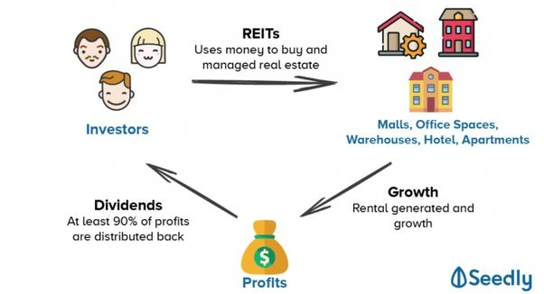
REAL ESTATE INVESTMENT TRUSTS (REITs)
Companies that own and manage properties.
Notes:
REITs stand for Real Estate Investment Trusts.
They are companies that own and manage properties such as malls, office spaces, warehouse, hotel and apartment..
They pool the funds from investors, use their money to manage properties, and these properties generate income. Then REIT will distribute 90% of the profits back to investors.

Slide 3
Analysis
Fundamental
Analysis (FA)
identify the intrinsic value of a stock
company’s financial statement and quality of management
Technical
Analysis (TA)
evaluating price and volume data
trends and patterns
to time entry and exit points
News Analysis
(NA)
Evaluate sentiment of news
Notes:
Commonly, there are three different types of analysis used when it comes to investment of REITs.
Fundamental analysis is used to identify the intrinsic value of a stock.
Technical analysis is to evaluate price and volume data of the equity.
News analysis is used to evaluate the sentiment of news.

Slide 4
Research gap
Significant amount of information
Struggle to combine all the methods
Lack of integrated FA, TA and NA analysis
Miss out on the advantage of other strategy
Benchmark-Adjusted Returns of Institutional Portfolios by Analysis Type
Method(s) Use | Benchmark-adjusted return of institutional portfolios (%)
Fundamental Analysis | 0.18
Fundamental and Technical Analysis | 0.27
D. Smith, C. Faugère, and Y. Wang, “Head and Shoulders Above the Rest? The Performance of Institutional Portfolio Managers Who Use Technical Analysis,” Res. Finance, vol. 29, pp. 167–189, Jan. 2013, doi: 10.2139/ssrn.2202060.
Notes:
There is a lot of information online. This makes the investors struggle to combine all the methods. Investor who only uses one strategy might miss on other advantage of other strategy.
A study shows that institutional portfolio who uses fundamental analysis got 0.18% of return, and those who use both fundamental and technical analysis got 0.27% of return.

Slide 5

Objective
Create a structured guideline
Integrate FA, TA and NA
Facilitate trading and portfolio allocation decisions
Notes:
The objective of this FYP is to create a structured guideline that integrates all types of analysis. This guideline will help investors to facilitate trading and portfolio allocation decisions.

Slide 6
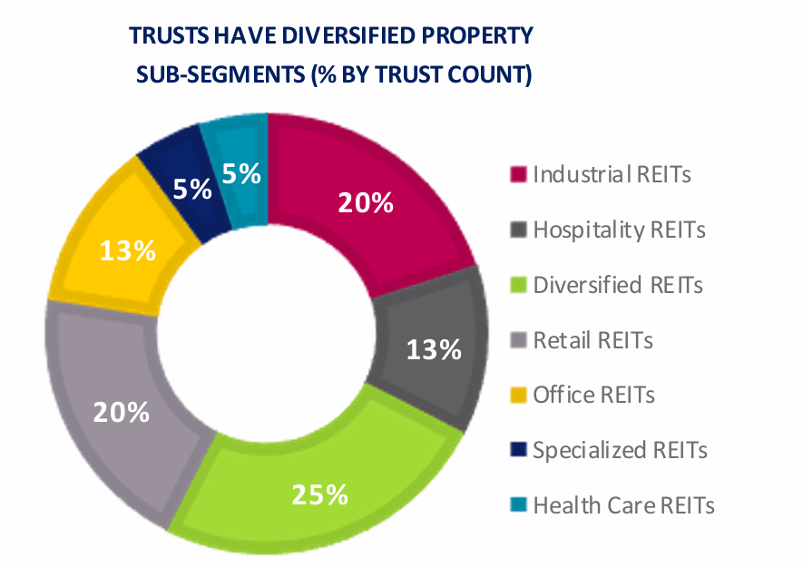
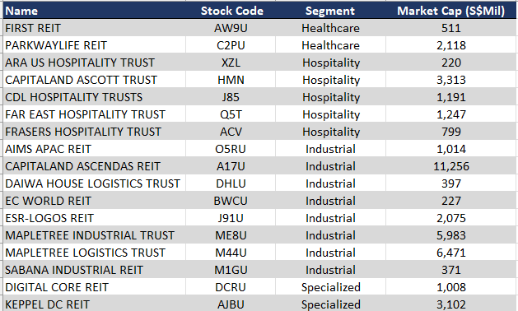
Scope
Notes:
My FYP will only cover Industrial, Hospitality, Specialized and Healthcare REITs. This table shows the relevant REITs.

Slide 7
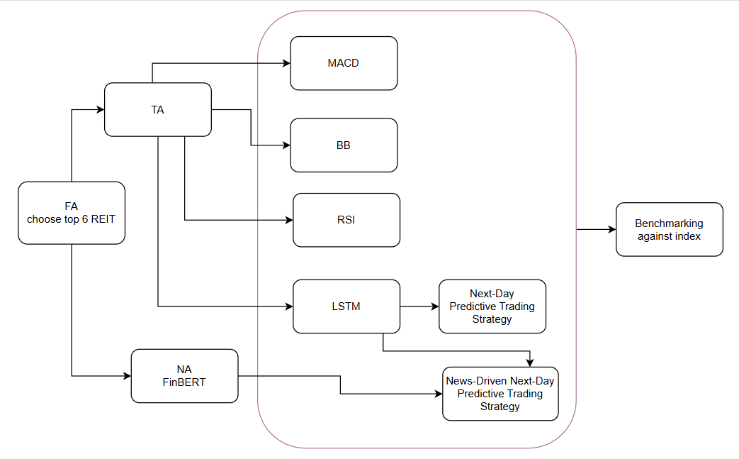
Method
Notes:
This is an overview of the method used.
Firstly, I will use FA to choose top 6 high performing REITs
Followed by TA, Technical Analysis which include traditional methods such as MACD, BB and RSI
Machine learning method LSTM, to predict the next day price
Finally I will incorporate the news analysis with the result of predicted price from LSTM.

Slide 8
Fundamental Analysis
10 quantitative metrics:
Net Property Income
Property Yield
Distribution Per Unit
Dividend Yield
Gearing Ratio
Net Asset Value
Funds From Operation
Occupancy Rate
1 Year Total Returns
3 Year Annualized Total Return
2 qualitative metric:
Economic outlook
Management quality
Notes:
These are all the metrics used in FA

Slide 9
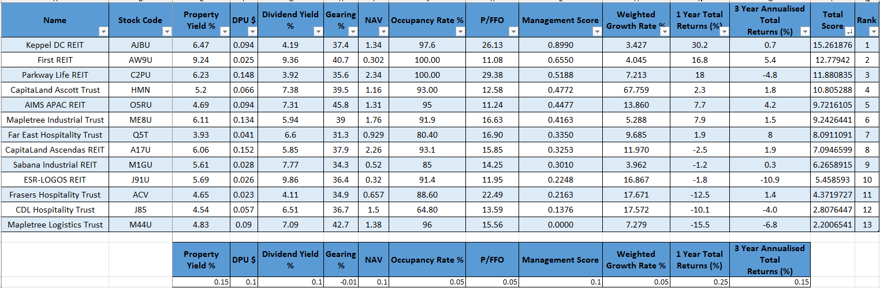
Result
The top 6 REITs are Keppel DC REIT, First REIT, Parkway Life REIT, CapitaLand Ascott Trust, AIMS APAC REIT and Mapletree Industrial Trust
Notes:
I collected all the metrics through company financial information.
Each of the metrics are given a weight based on their importance.
Each data is multiplied with their respective weight to calculate the total score
Rank is given based on the total score.
These are the top 6 REITs,

Slide 10
Technical Analysis
Traditional Method
MACD
BB
RSI
Machine Learning Method
LSTM
Notes:
After that, we proceed to Technical analysis.

Slide 11
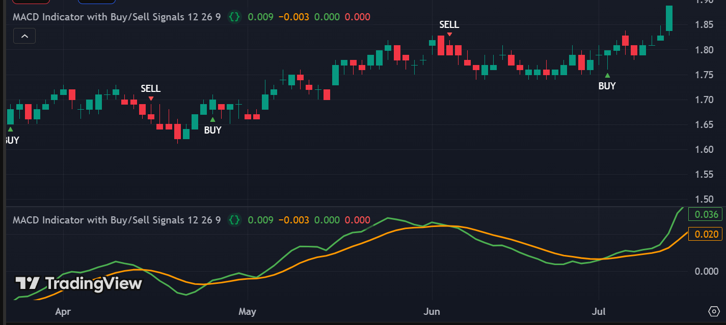
Moving Average Convergence/Divergence (MACD)
MACD indicates potential upward or downward momentum.
MACD line
12 Period EMA-26 Period EMA
Signal line
9 Period EMA
Bullish: MACD line crosses over the signal line
Bearish: MACD crosses below the signal line
Notes:
The first indicator is MACD, it indicates the potential upward and downward momentum.

Slide 12
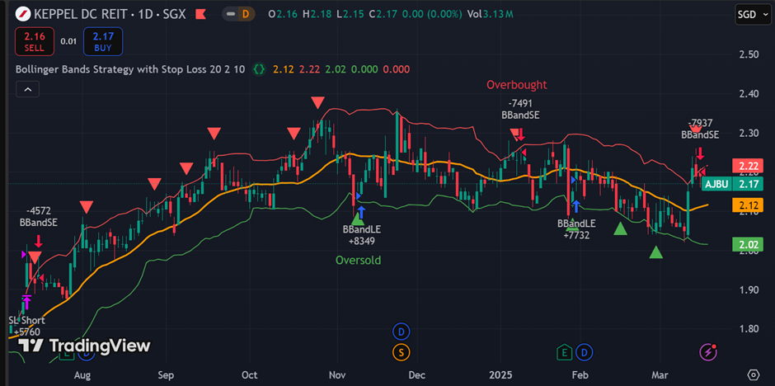
Bollingers Band (BB)
BB shows the price trends and market volatility based on standard deviation from the middle band.
Use upper band, lower band and middle band.
Bullish: Price crosses the lower band
Bearish: Price crosses the higher band
Notes:
Second indicator is Bollinger Band, BB, it shows the price trends and market volatility based on standard deviation from the middle band,

Slide 13
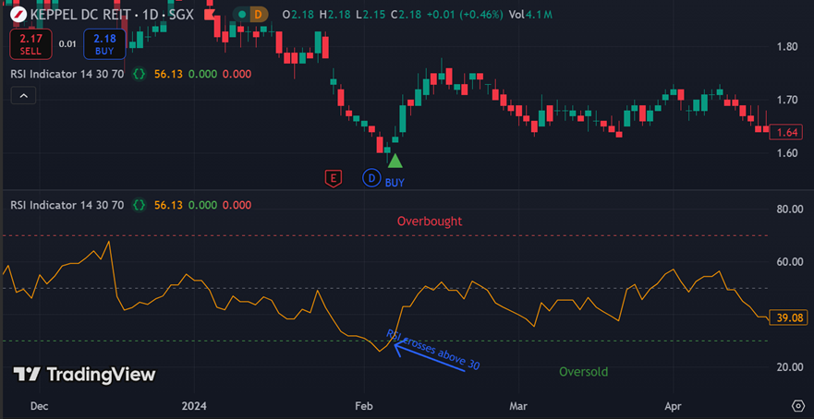
Relative Strength Index (RSI)
RSI measures the speed and magnitude of recent price changes.
Line graph that ranges between 0 to 100
Overbought: RSI above 70 signal to sell
Oversold: RSI below 30 signal to buy
Notes:
RSI measures the speed and magnitude of recent price changes.

Slide 14
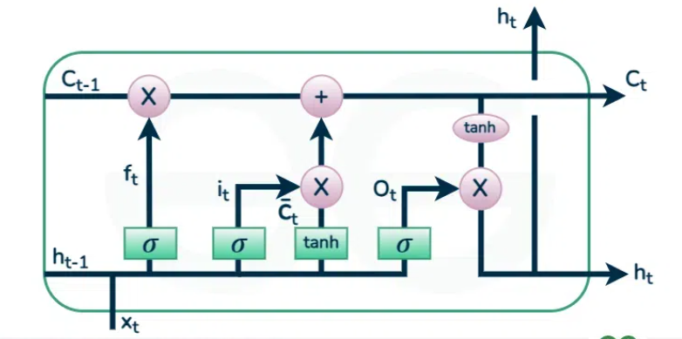
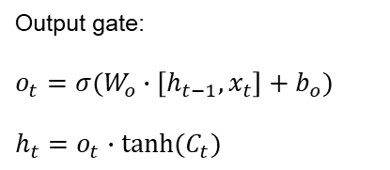
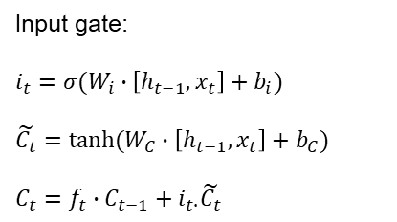
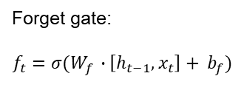
Long Short-Term Memory (LSTM)
Forget gate:
$$f_{t}=σ(W_{f }∙\left[h_{t−1}, x_{t}\right]+ b_{f})$$
Input gate:
$$i_{t}=σ(W_{i}∙\left[h_{t−1},x_{t}\right]+b_{i})$$
$$\tilde{C_{t}}=tanh⁡(W_{C}∙\left[h_{t−1},x_{t}\right]+b_{C})$$
$$C_{t}=f_{t}∙C_{t−1}+i_{t∙}\tilde{C_{t}}$$
Output gate:
$$o_{t}=σ(W_{o}∙\left[h_{t−1},x_{t}\right]+b_{o})$$
$$h_{t}=o_{t}∙tanh⁡(C_{t})$$
Notes:
Moving on to machine learning method, LSTM is used to predict the next day price.
A LSTM cell consist of forget gate, input gate and output gate.
Forget gate determines how much information from the previous state should be discarded.
Input gate determines how much of a new information from should be remembered in cell state.
Output gate determines the output passed to the next cell and other layers

Slide 15
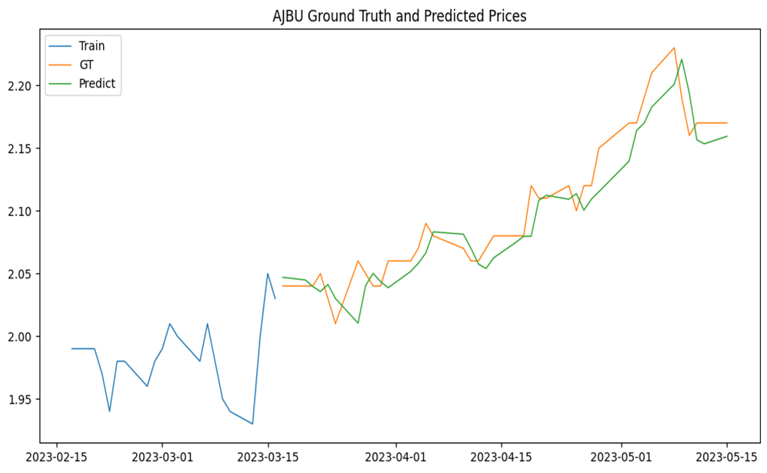
LSTM - NEXT-DAY PREDICTIVE TRADING STRATEGY
Long Entry Signal
Next day’s predicted price > today’s actual price
Short Entry Signal
Next day’s predicted price < today’s actual price
Exit Conditions
Signals reverse
20% stop loss
Notes:
This chart shows the result after applying LSTM
I designed a strategy to make use of the output of LSTM
This strategy will give a long entry signal when next day price is higher than current day close price
It will give short entry signal when next day price is lower than current day close price

Slide 16
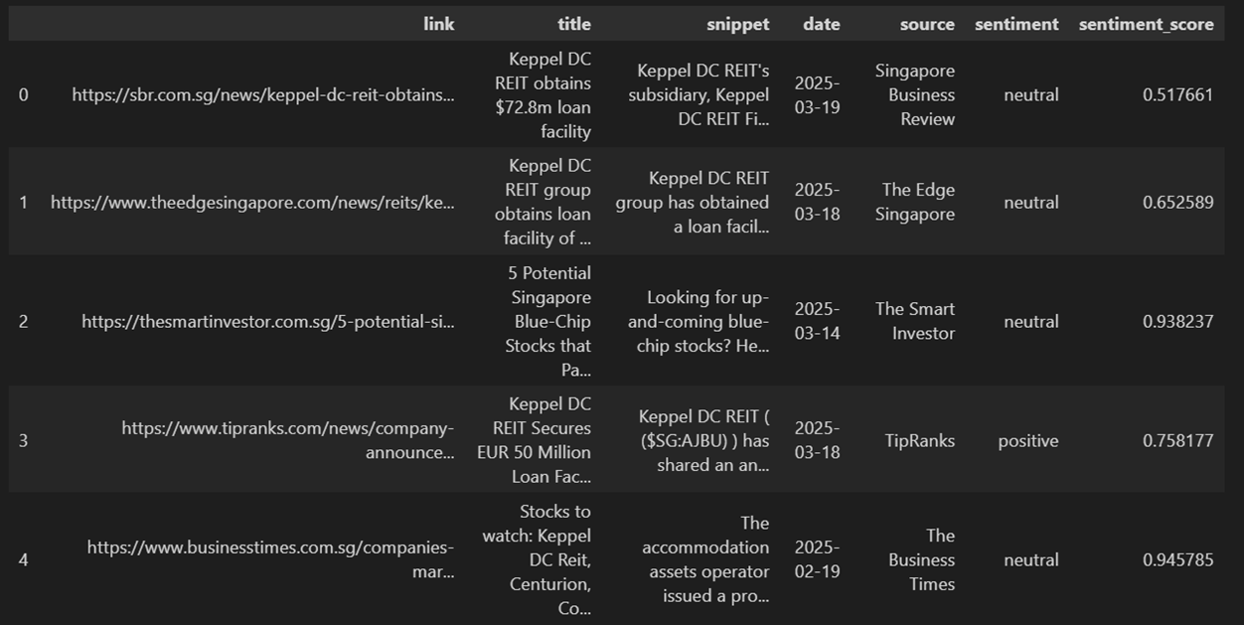
News Analysis
FinBERT
Existing model
Classify text into positive, negative or neutral
Notes:
In News Analysis, FinBERT model is used to classify news into positive, negative and neutral sentiment.

Slide 17
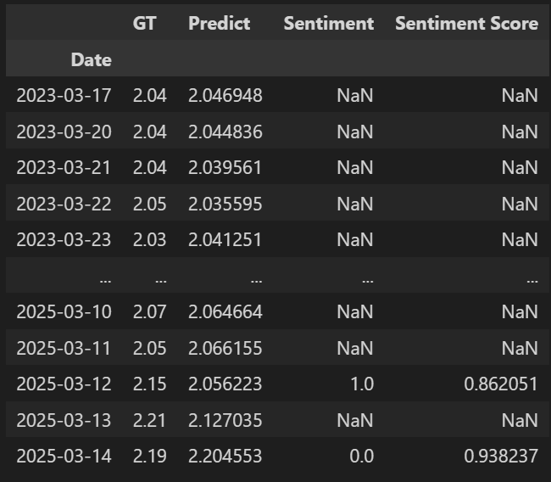
News-Driven Next-Day Predictive Trading Strategy
Long Entry Signal
Next day’s predicted price > today’s actual price and positive sentiment
Short Entry Signal
Next day’s predicted price is lower than today’s actual price and negative sentiment
Exit Conditions
Signals reverse
Hit 20% stop loss
Notes:
After classification, I designed a news-driven based strategy to trade the REITs based on the predicted price and sentiment.
Modify the strategy by adding sentiments onto it

Slide 18
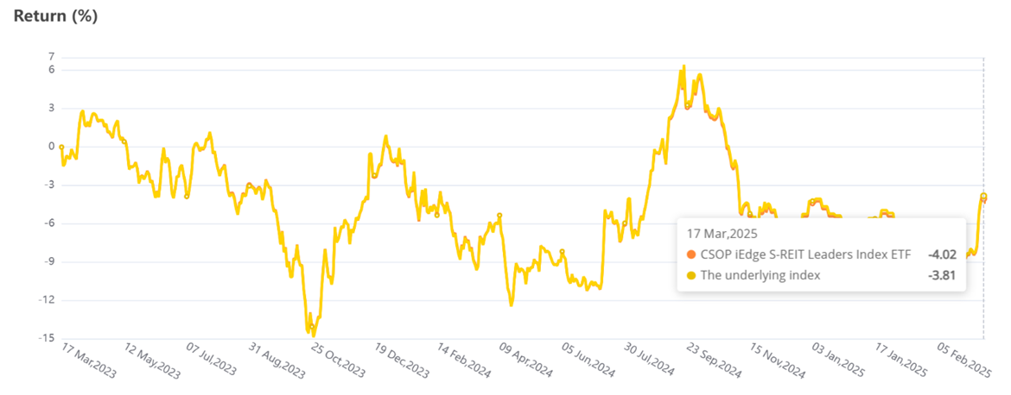
Benchmarking
To evaluate the investment’s performance objectively.
iEdge S-REIT Leaders Index.
A free-float market capitalization-weighted index that measures the performance of most liquid S-REITs.
Consists of other REITs.
Notes:
The last part is to use a benchmark to evaluate my trading strategy objectively.
The index chosen is iEdge S-REIT Leaders Index

Slide 19
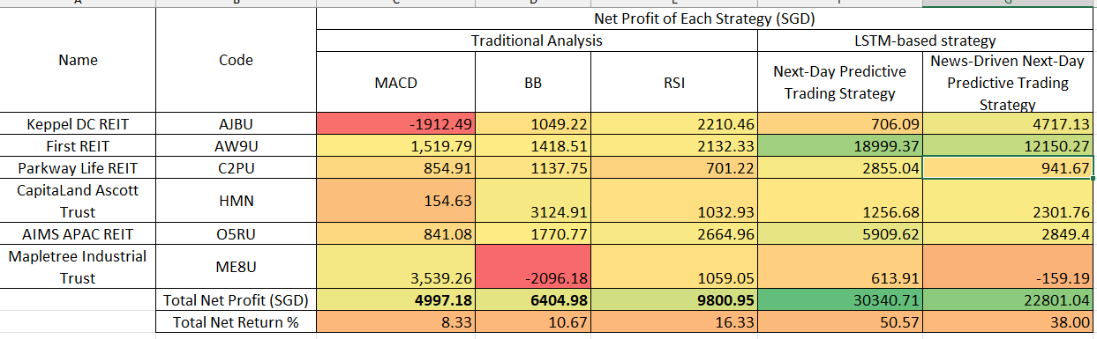
Result
Notes:
Here is the result of all the strategy.

Slide 20
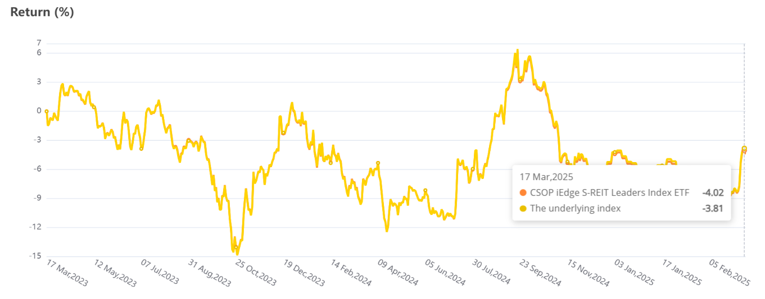
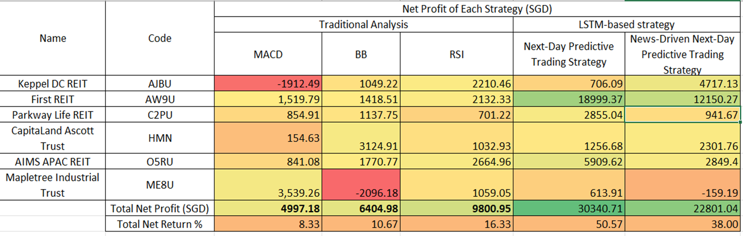
Discussion
Overall Performance
The return of iEdge S-REIT Leaders Index was -3.81%.
The ETF version (CSOP) performed slightly worse at -4.02%.
All investment strategies tested in this study generated positive net profits, clearly outperforming both the index and ETF benchmarks.
The stock-picking approach in this study was effective.
Notes:
The return of iEdge S-REIT Leaders Index and the ETF version were both negative.
However, all the investment strategies tested generate positive net return, which clearly outperforming both the index and ETF.
This prove that the stock picking approach was effective.

Slide 21
Discussion
R1) How do LSTM-based strategies perform compared to traditional analysis?
LSTM-based strategies outperform traditional analysis.
Ability of LSTM in capturing complex long-term and non-linear temporal dependencies in data.
Traditional indicators which only rely on fixed rules and historical price patterns.
RSI performs best among traditional strategies at 16.33%.
Notes:
LSTM based strategies outperform traditional analysis
This might due to LSTM capture long term and non linear temporal dependencies in data
But traditional indicators only rely on rules and patterns.
Among the tradional indicators, RSI perform the best.

Slide 22
Discussion
R2) To what extent does news sentiment influence the performance of LSTM-based trading strategies?
Performed worse.
Due to the added noise or unpredictability in sentiment data
Notes:
The strategy performed worse when news sentiments were added onto it.
This might due to the added noise or unpredictability in sentiment data.

Slide 23
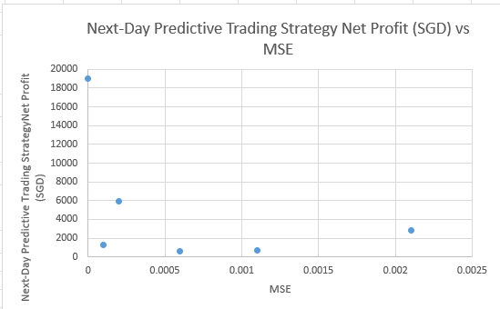
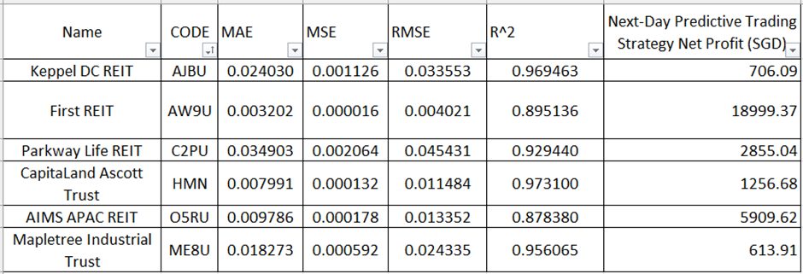
Discussion
R3) How does the predictive accuracy of the LSTM model (e.g., MAE, MSE, RMSE, R²) relate to the performance of its trading strategies?
No clear correlation.
Lower prediction error does not necessarily lead to higher trading returns.
Other factors i.e market volatility and trend clarity.
Notes:
The other finding was that there was no clear correlation between the accuracy of the model and the performance of trading strategy.
Lower prediction error does not lead to higher trading performance.
First REIT stands out as the most profitable asset, generating SGD 18999.37, despite having similar accuracy scores compared to other REITs. This suggests that factors like market volatility, trend clarity, and price movement patterns may play a larger role in profitability than accuracy alone.

Slide 24
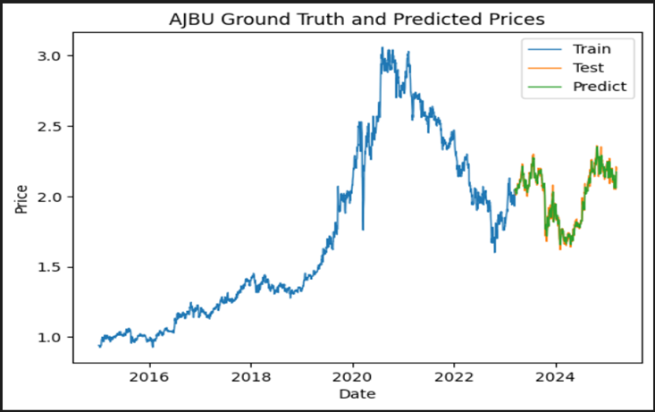
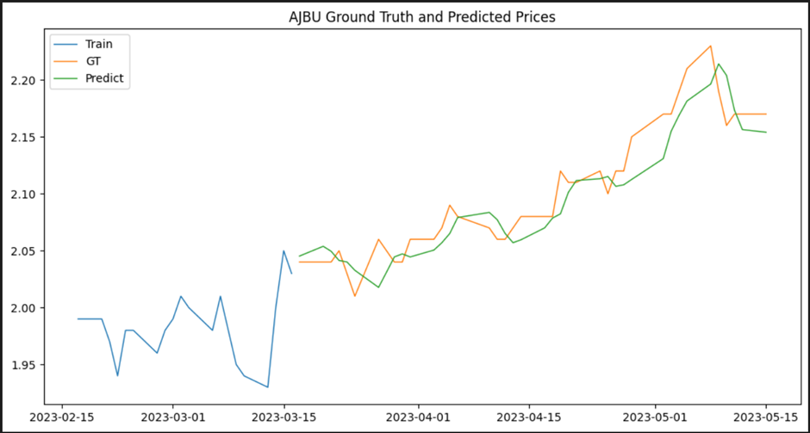
Discussion
R4) How reliable are the LSTM model’s predicted prices?
Predicted prices lag actual prices, especially at turning points.
Predicted price tends to mirror the shape of actual price curve with a one-day delay.
Fully predicting the future price movements vs replicating the recent patterns vs happen at the same time.
Rarely discussed in research.
Notes:
The other discussion was that the predicted price tends to mirror the shape of actual price curve with one day delay
This makes me wonder if the model is fully predicting the price movements or just replicating the recent patterns or just both happen at the same time.
Rarely discussed in any research.

Slide 25
Discussion
R5) What is the recommended guideline when investing in S-REIT based on this study?
Fundamental Analysis
Filter high performing REITs
Traditional Analysis
Use RSI
Stop loss at 10%
Machine Learning Strategy
Use LSTM for next-day price prediction
Suitable for advanced users
Be cautious of one-day lag at price turning points
Notes:
The guideline recommended is to start with filtering the high performing REITS
If investors are more comfortable with traditional analysis, they are recommended to use RSI
If investors want to take risk, they can use the machine learning strategy

Slide 26
Conclusion
LSTM-based strategies outperformed traditional technical analysis.
Higher model accuracy ≠ higher profits.
Predicted price lag in LSTM raises concerns about real-time trading reliability.
Further improvement: study about the one-day lag in LSTM, more input features, portfolio optimization
Notes:
In conclusion
LSTM-based strategies outperformed traditional technical analysis.
First REIT contributed most to overall profitability.
Higher model accuracy ≠ higher profits.
Predicted price lag in LSTM raises concerns about real-time trading reliability.
Further improvement: study about the one-day lag in LSTM, more input features, portfolio optimization Mean-Variance Optimization

Slide 27
Thank you

Slide 28
Appendix

Slide 29
Overview of Singapore REITs (S-REITs)
41
$87billion
Publicly traded REITs and Property Trusts listed
Market capitalization
6%
8.1%
Compound annual growth
in last 10 years
Average distribution yield
Notes:
Here are some statistics related to S-REITs. There are total of 41 REITs listed, with total of market capitalization of $87 billion.
The compound annual growth of S-REITs are 6% in last 10 years. That means if you invest 100$ 10 years ago, them u keep multiplying it by 1.06% then you will get 179 today.
The average distribution yield is 8.1%, means if you invest 100$, you get 8.1$ dividend this year.
Notes
The returns are compounded annually with a 6% growth
6% of growth are added to the principal investment

Slide 30
Formula of each financial metric.
Net Property Income | Net Property Income = Gross Revenue – (property maintenance fees + property taxes+ other operating expenses)
Property Yield | (Net Property Income/Property Value) X 100
Distribution Per Unit | Total Distributable Income/Total Number of Shares
Dividend Yield | (Annual Dividends Per Share)/(Current Stock Price) ×100 Percentage of a company share price that is paid out in dividends every year
Gearing Ratio | (Total Debt)/(Total Equity)
Net Asset Value | Assets-Liabilities
Funds From Operation | (Net Income+Depreciation+Amortization+Property Sales Losses)-Property Sales Gain-Interest Income
Occupancy Rate | the percentage of REIT’s properties that are currently leased

Slide 31
Quantification of management quality.
Management Fees/NPI
Management Fees Payable in Unit/Management Fees
Normalised using min-max normalization
management score= 0.7×Normalized Management Fee/NPI+0.3×Normalized Management Fees Payable in Unit/Management Fee

Slide 32
Justification of each metric
Metric | Weightage | Justification
Property Yield | 0.15 | This directly measures rental income productivity. A higher weight (0.15) underscores the importance of consistent cash flow from core operations.
DPU | 0.1 | Distributions per unit reflect actual payouts to investors. At 0.10, it provides meaningful emphasis without overshadowing broader returns.
Dividend Yield | 0.1 | Dividend yield (a percentage measure) complements DPU (an absolute measure). Weighting it at 0.10 ensures income-focused investors see sufficient representation.
Gearing | -0.1 | A negative weight penalizes higher leverage, as excessive debt increases risk and can lead to volatility in distributions.
NAV | 0.1 | Net Asset Value is a snapshot of the REIT’s underlying property value. A smaller weight (0.05) recognizes its role but keeps the focus on income and returns.
Occupancy Rate | 0.05 | Occupancy is a leading indicator of operational health. A modest weight prevents short-term fluctuations from dominating the overall assessment.

Slide 33
Justification of each metric
P/FFO | 0.05 | A valuation metric specific to REITs. A 0.05 weight accounts for fair pricing and avoid overpaying for a REIT’s cash flow.
Management Score | 0.1 | Quality of management can affect long-term success, but it’s often subjective. Thus, a 0.05 weight includes it without letting it overshadow quantitative metrics.
Weighted Growth Rate | 0.05 | Reflects the longer-term expansion in income or assets. A 0.05 weight keeps it in view while prioritizing total returns and immediate yield.
1 Year Total Returns | 0.25 | A heavier emphasis on short-term performance. By assigning 0.25, you give substantial weight to recent market performance, recognizing momentum or near-term results.
3 Year Annualised Total Returns | 0.15 | Rewards medium-term consistency and sustained returns. At 0.15, it balances the short-term focus (1-year returns) with a longer outlook on performance stability.

Slide 34
Technical Analysis (Traditional Method) 17 march 2023 to 17 march 2025 10000$
Indicator | Formula
Moving Average Convergence/Divergence (MACD) | Indicates potential upward or downward momentum MACD line=12 Period EMA-26 Period EMA Signal line=9 Period EMA Bullish: MACD line crosses over the signal line Bearish: MACD crosses below the signal line
Bollingers Band BB | Use upper band, lower band and middle band. Shows the price trends and market volatility based on standard deviation from the middle band. Bullish: Price crosses the lower band Bearish: Price crosses the higher band
Relative strength index | Momentum indicator Measures the speed and magnitude of recent price changes Depicted as a line graph that ranges between 0 to 100 Overbought: RSI above 70 signal to sell Oversold: RSI below 30 signal to buy
Implemented using TradingView.

Slide 35
Research Questions
R1) How do LSTM-based strategies perform compared to traditional analysis?
R2) To what extent does news sentiment influence the performance of LSTM-based trading strategies?
R3) How does the predictive accuracy of the LSTM model (e.g., MAE, MSE, RMSE, R²) relate to the performance of its trading strategies?
R4) How reliable are the LSTM model’s predicted prices?
R5) What is the recommended guideline when investing in S-REIT based on this study?

Slide 36
Parameters for Traditional Analysis
Initial Capital: $10,000
Trade Sizing: 80% of available equity
Stop Loss: 10%
Date Range: March 17, 2023 – March 17, 2025
Notes:
These are the parameters for all the traditional method.

Slide 37
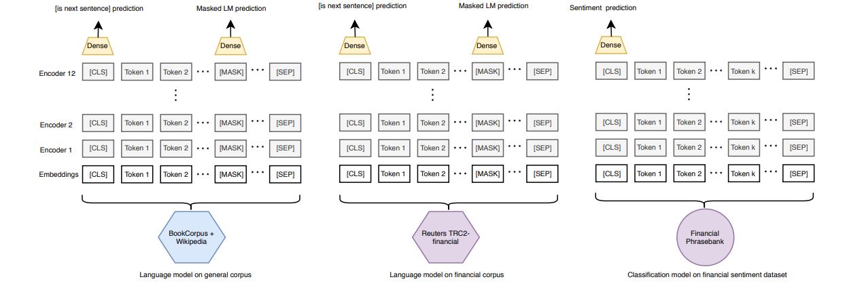
News Analysis
FinBERT
pre-trained on the TRC2-financial dataset
fine-tuned on the Financial PhraseBank dataset
evaluated using the FiQA Sentiment dataset
classify text into positive, negative or neutral

